Slide 1
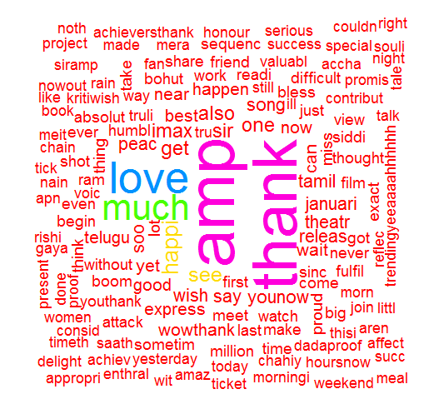
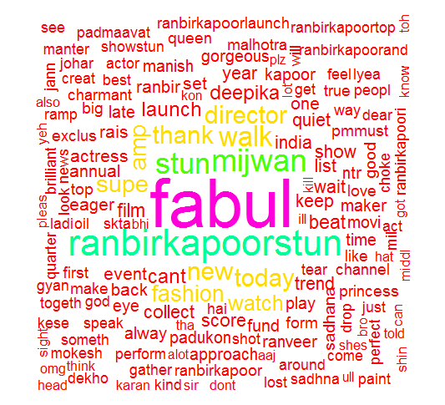
Tweets by Deepika
Tweets on Deepika
Sentiment Score = 89 – 8 = 81
Sentiment Score = 280 – 152 = 128

Slide 2
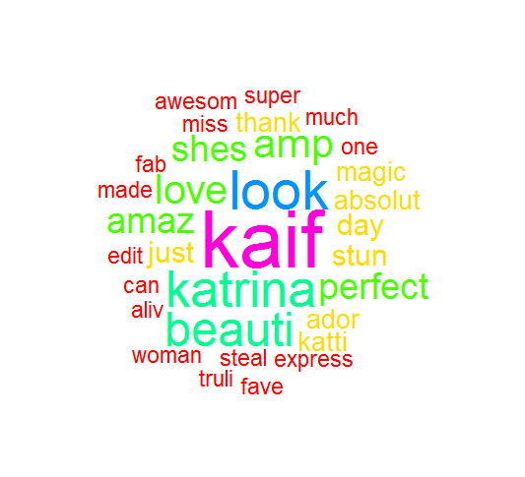
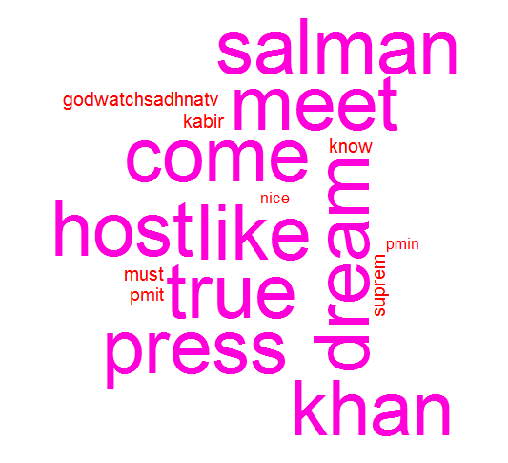
Tweets by Katrina
Tweets on Katrina
Sentiment Score = 36 – 10 = 26
Sentiment Score = 192 – 0 = 192

